Slide 1
Linear Regression Model For Imdb Dataset

Slide 2
Contents
Introduction
Data Wrangling
Exploratory Data Analysis
Machine learning Model (Linear Regression)
Conclusions

Slide 3
Introduction
In this project I will work on a Imdb-movies data which has the properties for the movies which has been released and my goal
to predict IMDB ratings for movies

Slide 4
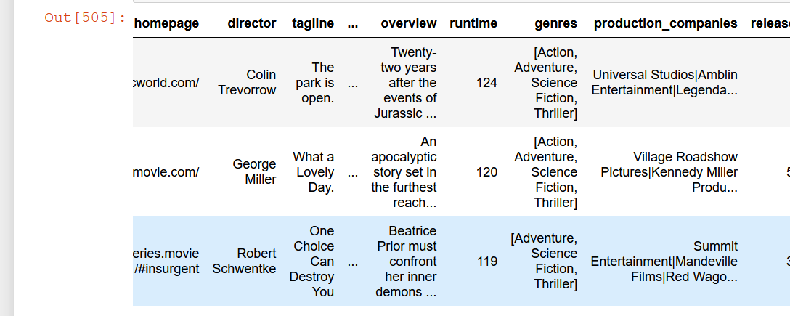
Data Wrangling
Data Cleaning
check for duplicated rows-drop
null values
rename columns for better readability
drop unnecessary columns

Slide 5
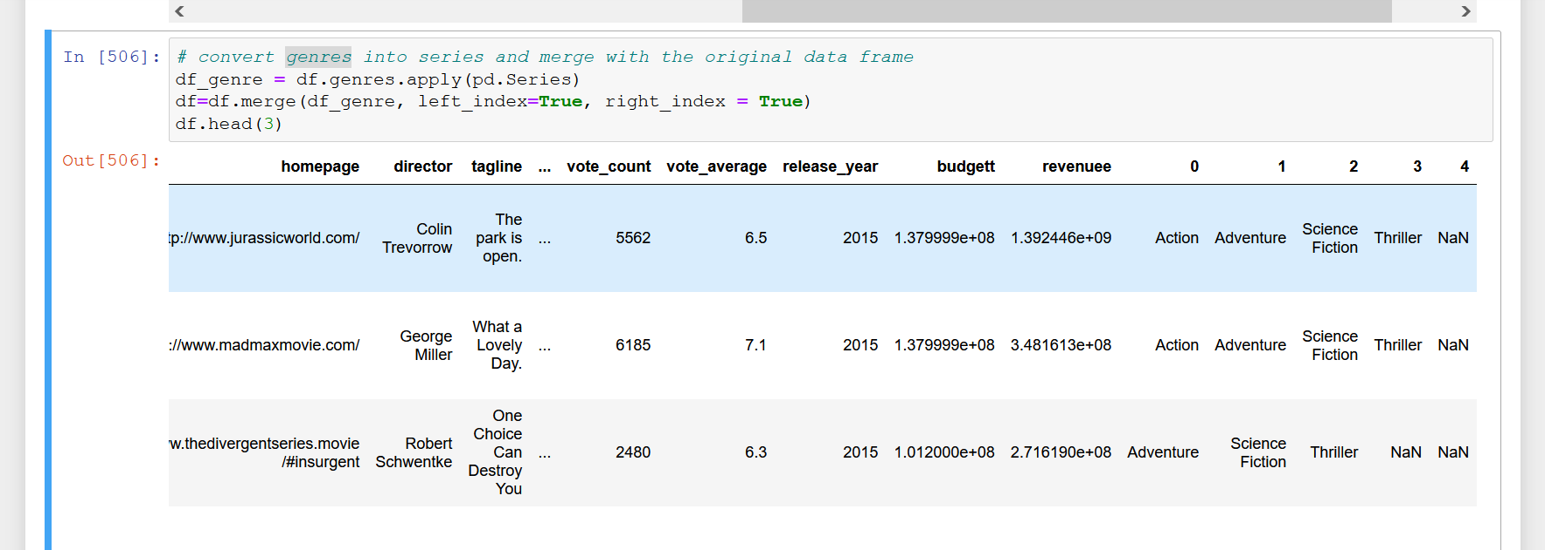
Data Wrangling

Slide 6
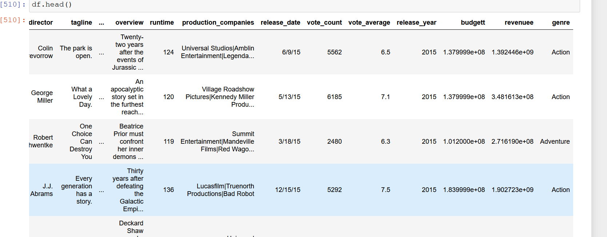
Data Wrangling

Slide 7
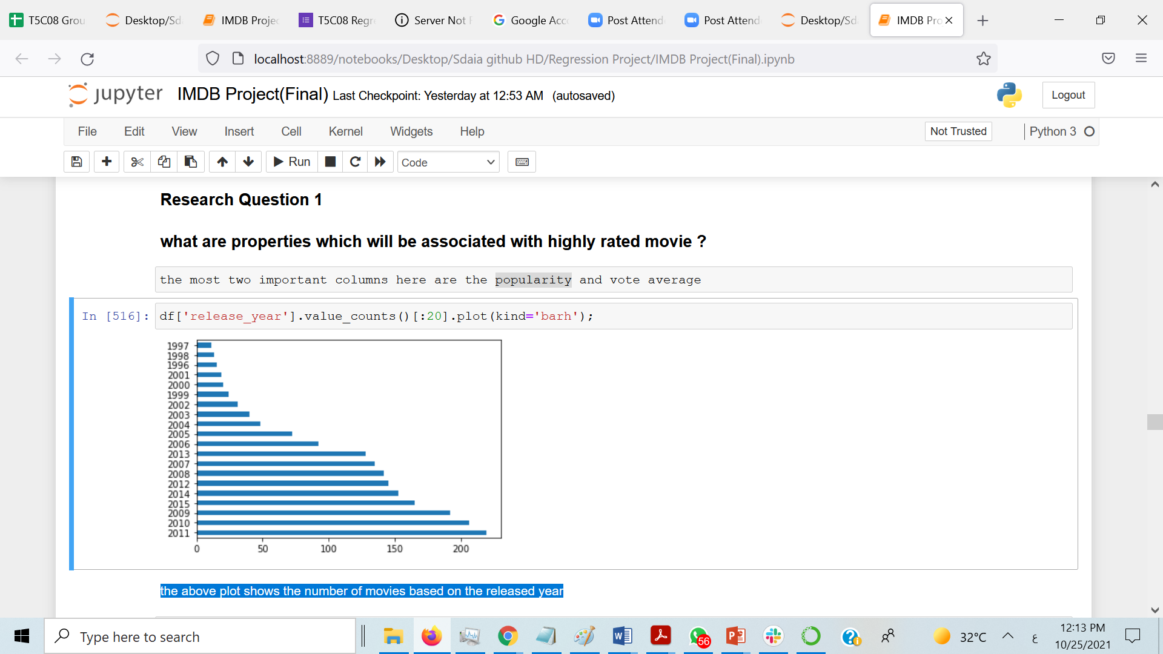
Data Wrangling
The above plot shows the number of movies based on the released year

Slide 8
Exploratory Data Analysis
Research Question 1
what are properties which will be connected with highly rated movie ?
Research Question 2 (Does high budget movies affect on high voting of viewers?
what is the period in which there are high voting movies?

Slide 9
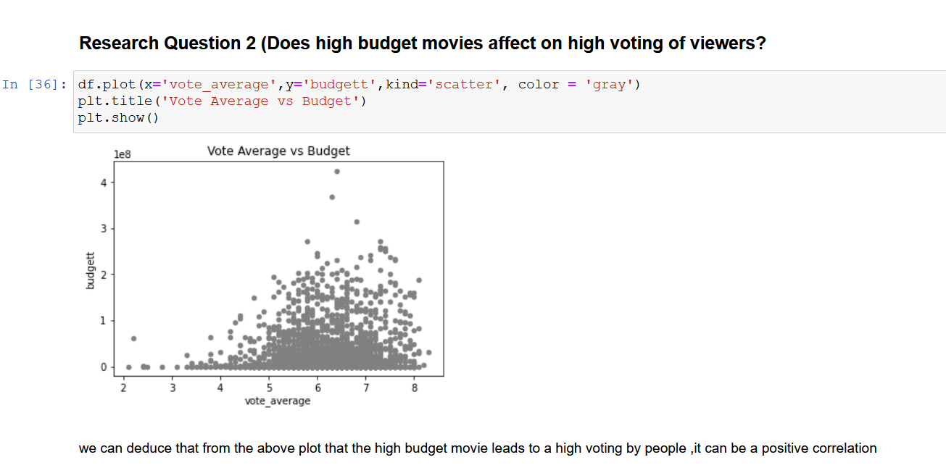
Data Wrangling
the high budget movie leads to a high voting by people

Slide 10
Machine learning Model (Linear regression)
Algorithm
linear Regression model =Testing score: 20.0 %
Decision Tree Regressor = Testing score: 40.0 %
Kneighbors Regresso = Testing score: 50.0 %

Slide 11
Conclusions
There many factors that affect movies and make it unique from one another ,in this project I do analyse these factors and know which of them affect movie popularity.
I also found that movies released between 1970-1985,leads to be voted higher than others.
I found the score is low when I used linear regression so I tried another algorithm to improve the score of the model.

Slide 12
Thank you

